Slide 1
Data Structures Workshop
Day 24

Slide 2
Workshop Outline
AVL Trees Overview
Tracing Examples (Finish Worksheet From Last Workshop)
Coding Implementations
Introduction to B-Trees

Slide 3
AVL Trees

Slide 4
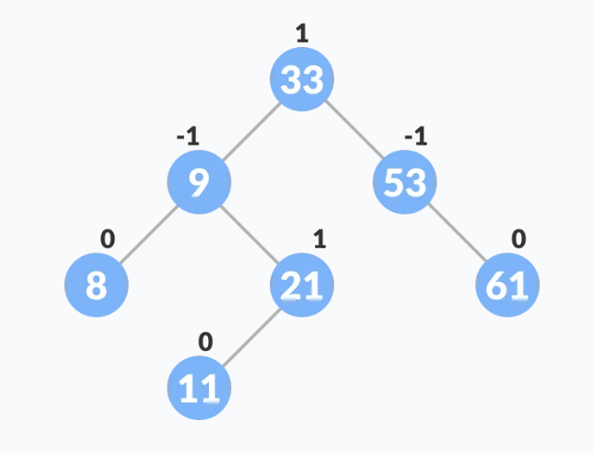
Summary
As discussed last workshop, an AVL tree is a self-balancing Binary Search Tree in which every node contains something called a “balance factor”.
The balance factor of a given node should always be -1, 0 or 1.
The self balancing property of an AVL tree is maintained by this balance factor.

Slide 5
AVL Rebalancing Cases
In order for our AVL tree to remain balanced at all times, there are certain operations we must implement to correct our AVL tree when it becomes unbalanced, we call these operations “rotations”.
Single Rotations:
Left Left Case (Rotate Right)
Right Right Case (Rotate Left)
Double Rotations:
Left Right Case (Rotate Left , then Rotate Right)
Right Left Case (Rotate Right, then Rotate Left)

Slide 6
Worksheet Solutions
Let’s go through problems 2 & 3 from last Tuesday’s workshop.
Be comfortable with AVL insertion and deletion for the Final Exam.

Slide 7
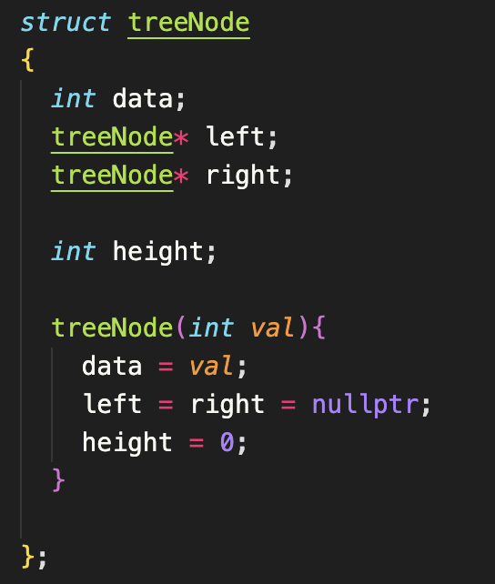
AVL Implementation
Our tree node struct will be very similar to that of a BST, except we will now include a height data member.
This will be needed when calculating the balance factor of every node in our AVL tree

Slide 8
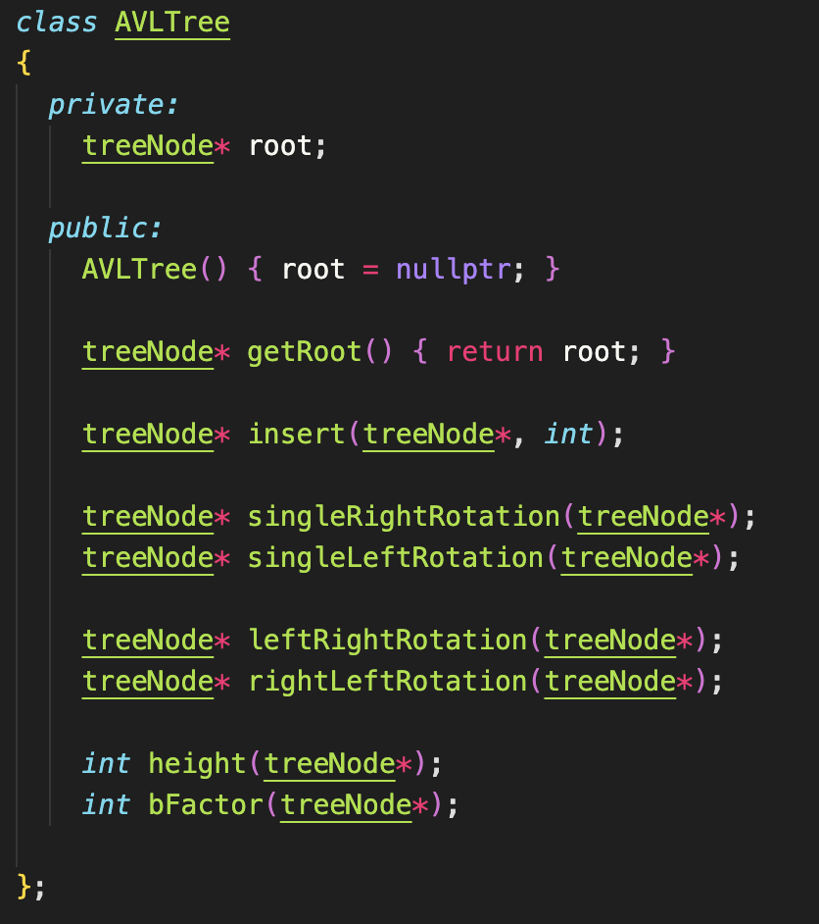
Method Functions
Within the AVL implementation, we have the following method functions:
Insertion
Deletion
Rotation Cases for Balancing
Get Height
Balance Factor

Slide 9
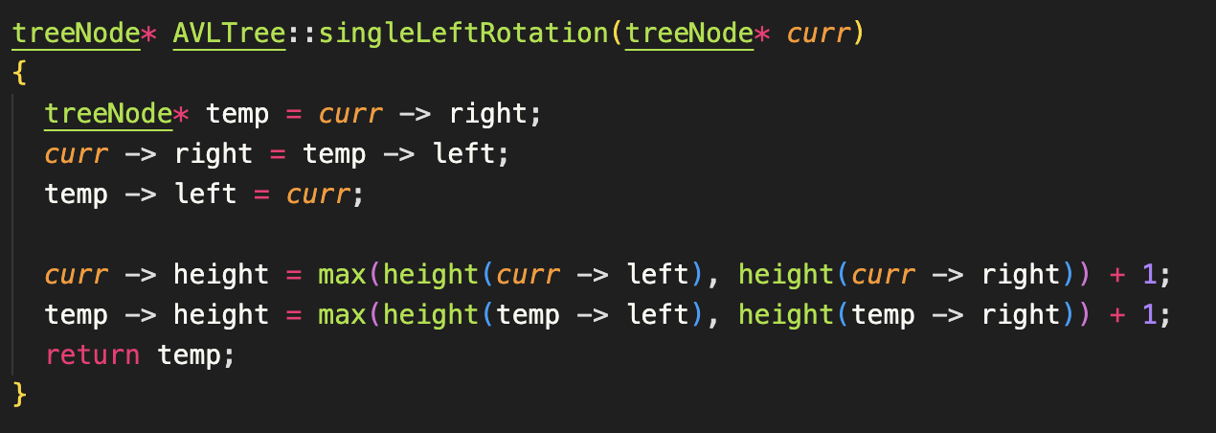
Left Rotation Implementation
The idea here is to make the parent’s right child node, the new parent. The old parent will now become the new parents left child.

Slide 10
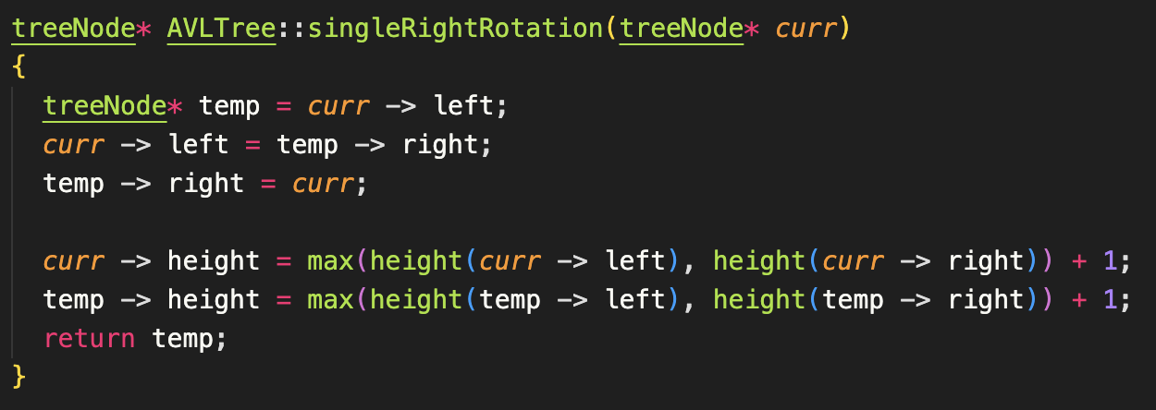
Right Rotation Implementation
Same idea follows here, except we do the opposite

Slide 11
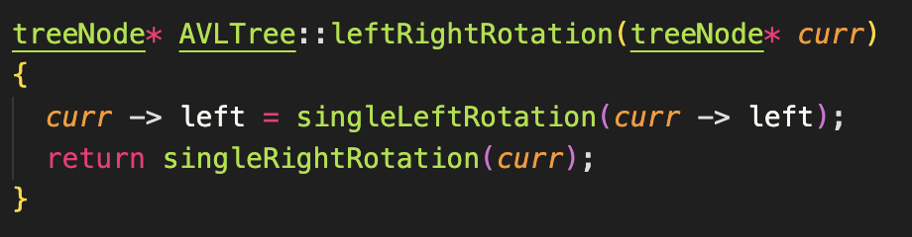
Left Right Rotation
Recall that with a Left Right Rotation, you first call a Left Rotation on the parent node’s left child, then you call the right rotation on the parent node.

Slide 12
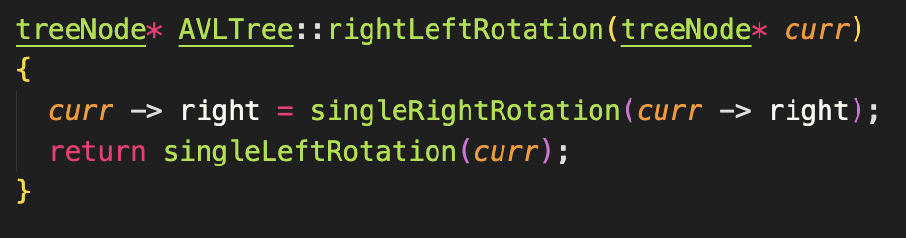
Right Left Rotation

Slide 13
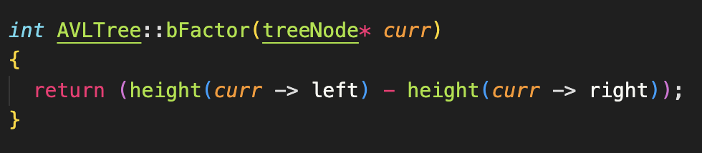
Balance Factor
Remember how to calculate a node’s balance factor:
Height of Left Subtree - Height of Right Subtree
Notes:
treeNode* AVLTree::insert(treeNode* curr, int val)
{
if(curr == nullptr)
{
curr = new treeNode(val);
}
else if(val < curr -> data)
{
curr -> left = insert(curr -> left, val);
if(bFactor(curr) == 2)
{
if(val < curr -> left -> data)
curr = singleRightRotation(curr);
else
curr = leftRightRotation(curr);
}
}
else if(val > curr -> data)
{
curr -> right = insert(curr -> right, val);
if(bFactor(curr) == -2)
{
if(val > curr -> right -> data)
curr = singleLeftRotation(curr);
else
curr = rightLeftRotation(curr);
}
}
curr -> height = max(height(curr -> left), height(curr -> right)) + 1;
return curr;
}

Slide 14
BST vs. AVL
Given a sequence of elements: 10, 18, 16, 2, 8, 3, 1​
Create a BST
Create a AVL
See the difference between an AVL and a BST​
Make sure to show the tree after each insertion​

Slide 15
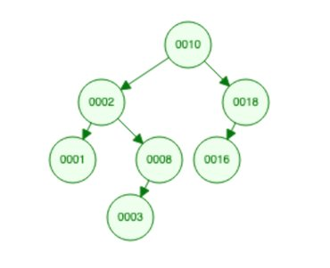
BST Solution

Slide 16
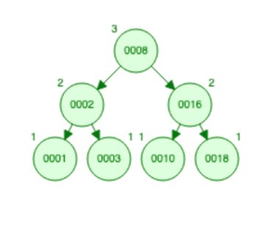
AVL Solution
Where is our original root?
Any other differences you noticed?

Slide 17
B-Trees Introduction

Slide 18
B Tree Concept​
A B-Tree is a special type of self-balancing search tree in which each node can contain more than one value (key) and can have more than two children.
(Think of this as an optimization over BST and AVL Trees)
Arose with the rise in the need for lesser time in accessing physical storage media like a hard disk.
B-Trees can store many values in a single node and can have multiple child nodes. This decreases the height significantly allowing faster disk accesses.

Slide 19
B-Tree Properties
1. In all nodes, values are stored in increasing order
2. If n is the order of the tree, each internal node can contain at most n - 1 keys along with a pointer to each child
3. Each node except root can have at most n children and at least n/2 children
4. All leaves have the same depth
5. Root has at least 2 children and contains minimum of 1 key

Slide 20
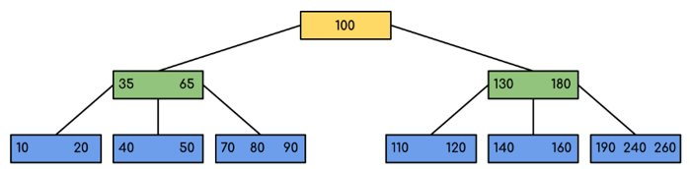
B Tree Visualization

